Slide 1
Web Server log processing in Hadoop
On Azure Virtual Machine

Slide 2
Agenda
Understanding the use case
Using Azure VM
Setup Hadoop Environment
Store files in HDFS using Flume
Process Logs in Spark
Access processed data in Hive

Slide 3
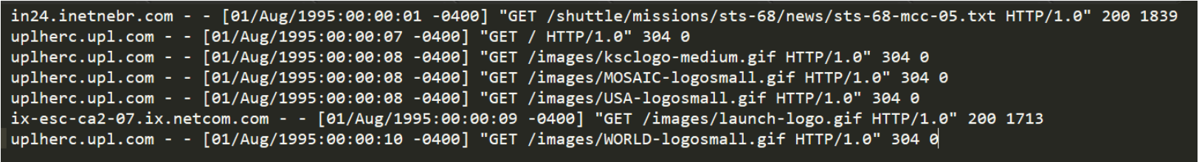
Understanding the use case
Log File
Data set is taken from NASA
Columns
host that made the request to the server
user-identifier is the RFC 1413 identity of the client.
User Id of the person requesting the document
date and time when the call was made with time zone for the caller
the request line for the call
the http status code for the call
the size in bytes of the response

Slide 4
Using Azure VM
Creating Azure Resource Group
Creating Azure VM
Create Ubuntu Virtual Machine
Adding additional 128GB Disk Storage
Accessing VM on Putty
Mounting the Disk to the VM

Slide 5
Setup Hadoop Environment
Install the following softwares
Hadoop
Hive
Flume
Spark

Slide 6
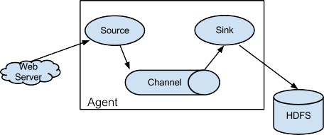
Store files in HDFS using Flume
Create Flume Configuration file
Flume Agent
Source
Sink
Channel
Run the Flume Agent

Slide 7
Process Logs in Spark
Scala
Download SBT(Scala Build Tools / IntelliJ IDEA IDE)
Create a simple project
Generate code to process Web Server Logs
Compile and generate jar file
Spark Job
Start Hadoop
Create Source and Destination directories
Add data to source directory
Submit Spark Job on Yarn Cluster

Slide 8
Access processed data in Hive
Start Hive Shell
Create a new Database
Create a table on the output directory of Spark
Create views on the table as needed

Slide 9


